Slide 1
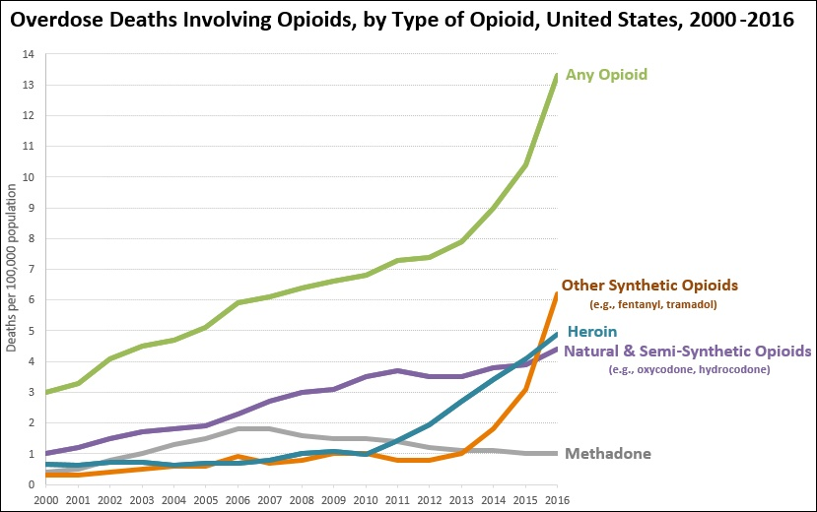
Census data & the opioid crisis
Graphic by Centers for Disease Control and Prevention. Original chart was cropped by User:Timeshifter. Freeware IrfanView was used. - Chart from Data Overview. Drug Overdose. CDC Injury Center., Public Domain, https://commons.wikimedia.org/w/index.php?curid=57233023

Slide 2
Questions
Can county-level opioid death rates be predicted from US census data?
What are the most relevant predictors for the death rates?

Slide 3
What data?
pop_inc
foreign_07
foreign_inc
median_age
hh_afr_am
hh_hispan
hh_female
vets
vets_male
urban_inf
poverty
pov_change
median_hh_inc
hh_food_st
Economics
Demographics
Employment
unemployment
unemp_change
Crime
viol_crime
prop_crime
Education
< diploma
degree+

Slide 4
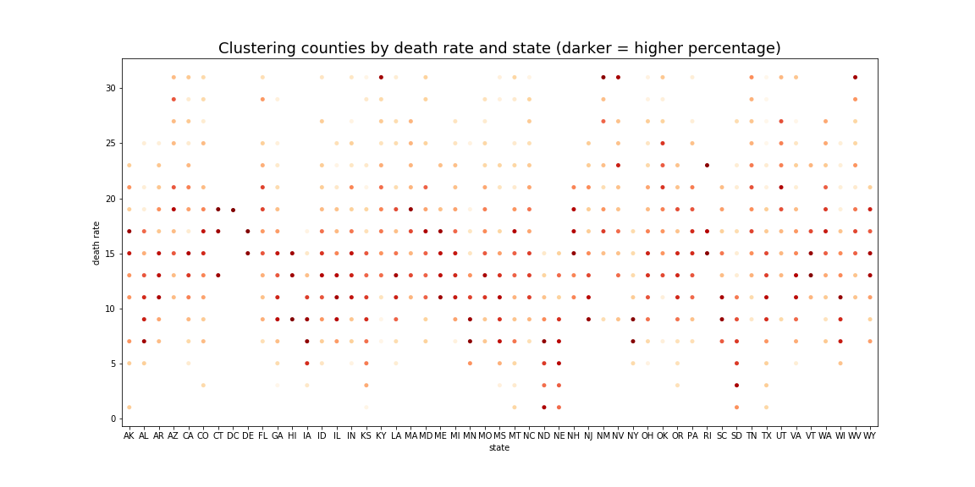
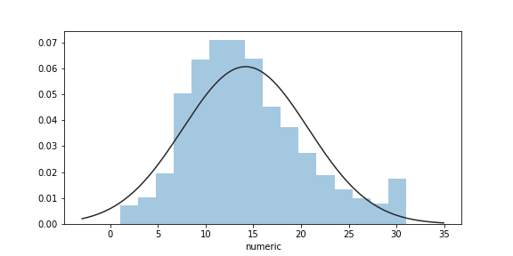
Overall distribution of
county death rates

Slide 5
Feature engineering
First pass
Turn counts into decimal percentages
Sum annual foreign population increase to get 5-year change
Add numeric death rate values to allow correlation analysis with predictors
Second pass (after correlation analysis)
Add property and violent crime rates to get unified crime measure
Drop poverty feature because of high correlation with several other features
Dummy urban influence feature (it is not a continuum)
Third pass (after initial models)
Create poverty and unemployment change rates by subtracting 2010 from 2014
Combine target ranges (initially 16 classes) into 8 classes, then 4 and finally 2

Slide 6
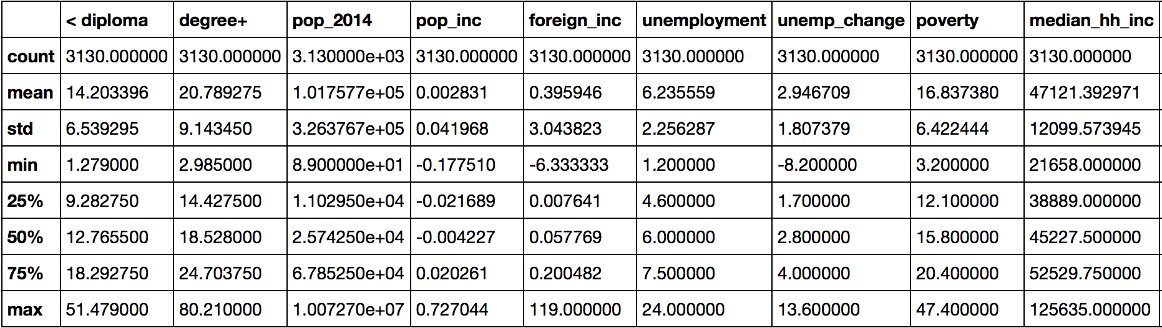
Analyzing the data
Although not all the features are shown here, eyeballing the IQRs (75% - 25%) for each feature along with the 25% and 75% values, and estimating the -/+ 1.5 * IQR lower and upper cutoffs for outliers vs. the min and max values shows that essentially every feature has outliers. We’ll come back to this.

Slide 7
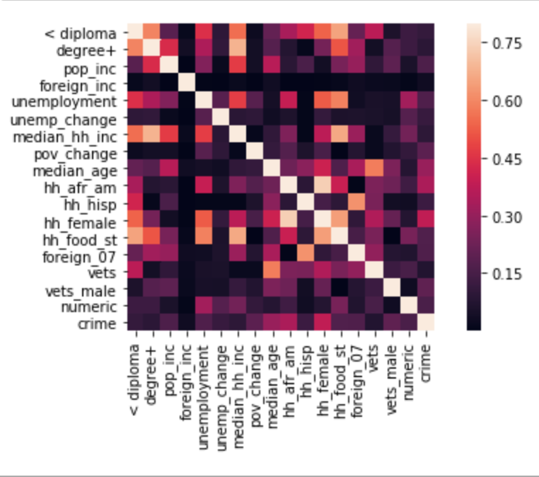
Correlations & multicollinearity
The poverty feature had many strong correlations and was removed, but others have various medium-strong correlations. Should some be removed?
VIF

Slide 8
Variance inflation factor
The VIF for the k^{th} predictor is the reciprocal of the R² value obtained from regressing it on the other k-1 predictors.
So the higher the multicollinearity is between any predictor and the rest of the predictors, the greater the R² value will be, and the greater the VIF. There is debate over what value for a VIF is too large, but lower is better.
Multicollinearity is expected to be a problem with the observational census data.
$$VIF_{k}=\frac{1}{1-R_{k}^{2}}$$

Slide 9
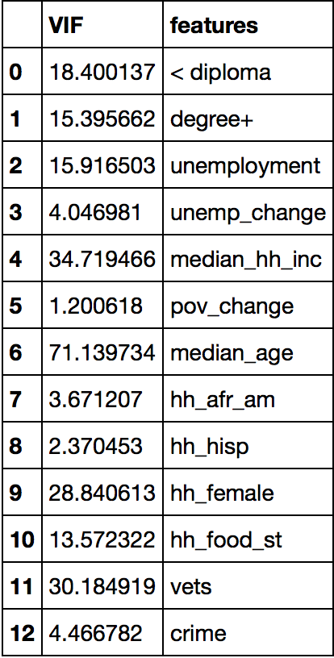
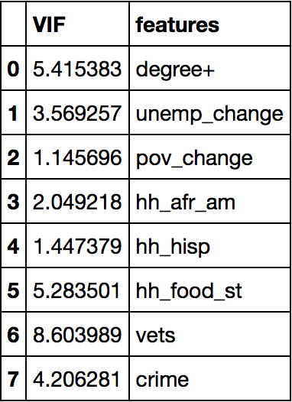
Variance Inflation Factor analysis
All the features are not present because this is from the feature selection for the second feature set (f2), which started with just those features that had a Pearson correlation coefficient of at least .05 with ‘numeric’. Set f1 applied VIF analysis to all the features.

Slide 10

Outliers
Outliers are a concern
half the samples contain outliers
almost 1/3 contain extreme outliers more than 2.5 * IQR below/above the 1st/3rd quartiles
Strategies
Progressively remove samples with
2 or more extreme outliers
any extreme outliers
Use robust scaling
Note to self: Dummying a categorical variable with 3 or more categories can lead to EVERY value being an outlier.

Slide 11
Models
The classifiers used were:
logistic regression
gradient boosting
stochastic gradient descent
random forest
support vector
k-nearest neighbors
The scoring used for model comparison was the Matthews correlation coefficient (MCC), which uses all four error categories (true/false positives/negatives) and so is particularly appropriate for multi-class classification.

Slide 12
Model performance (MCC scores)
 | log reg | gr boost | sgd | rand for | svc | knn
f1 | 0.04625 | 0.04343 | 0.01381 | 0.03273 | 0.05799 | 0.01429
f2 no xx | 0.06136 | 0.02673 | 0.05243 | 0.02611 | 0.0761 | 0.04919
f2 no x | 0.04718 | 0.04305 | 0.03052 | 0.03567 | 0.05667 | 0.04316
8 class | 0.1406 | 0.09624 | 0.08021 | 0.09300 | 0.13383 | 0.07313
4 class | 0.23639 | 0.22512 | 0.16326 | 0.17806 | 0.2187 | 0.19654
2 class | 0.39271 | 0.33052 | 0.21780 | 0.26930 | 0.39231 | 0.29266
test | 0.37061 |  |  |  | 0.41848

Slide 13
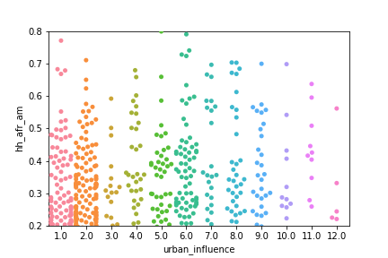
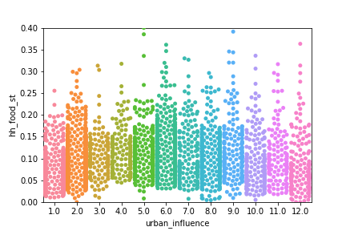
Interesting relationships
Urban influence has to be treated as a categorical variable, since it does not act as a continuum, even though 1 is the most urban and 12 the most rural. It is broken into several categories and goes from most to least populated in each. (A useful reference can be found at https://www.ers.usda.gov/data-products/urban-influence-codes/documentation/)
These plots show that high percentages of African-American households are spread through many of these categories, not just in the largest urban centers, and that households receiving food stamps are spread almost uniformly.

Slide 14
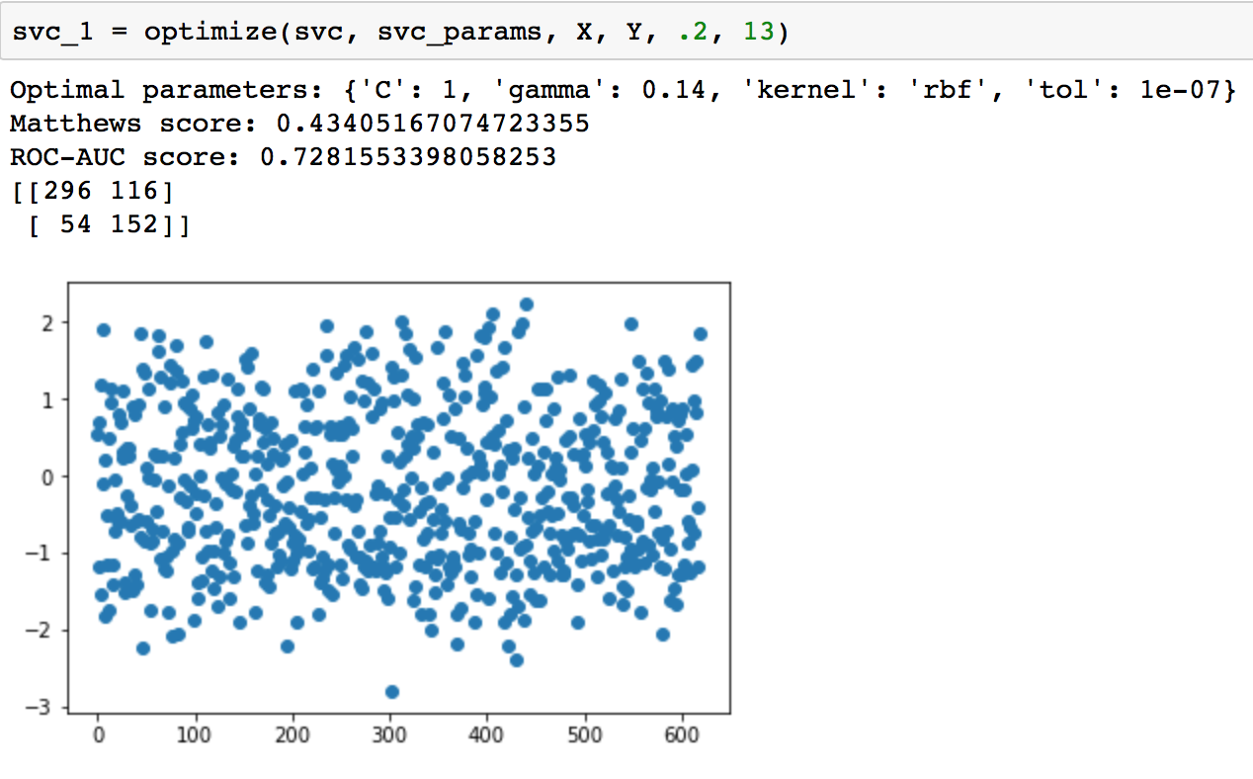
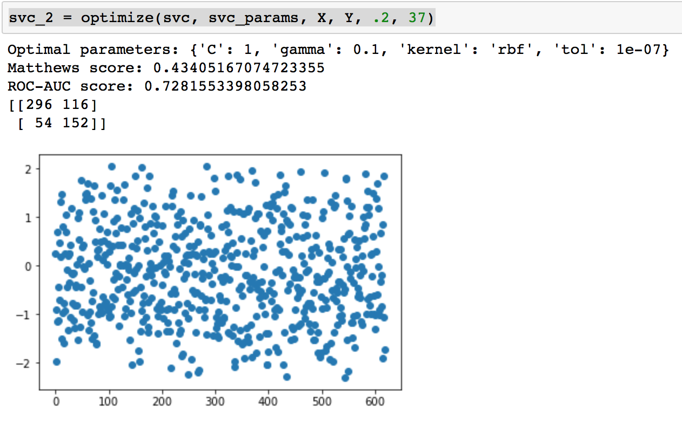
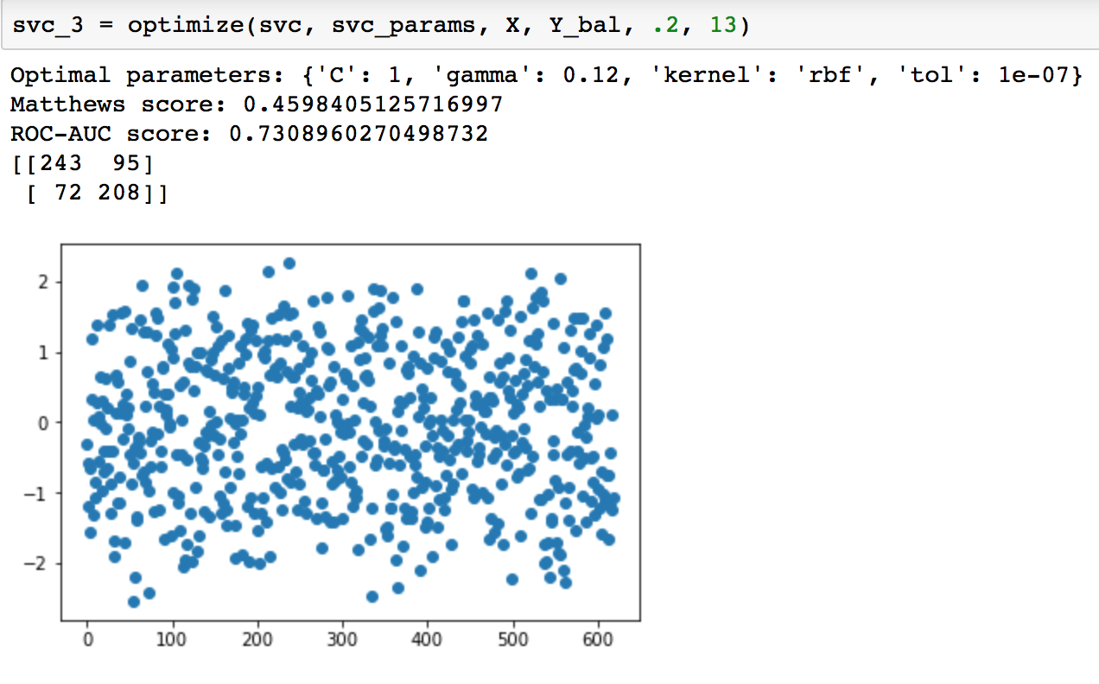
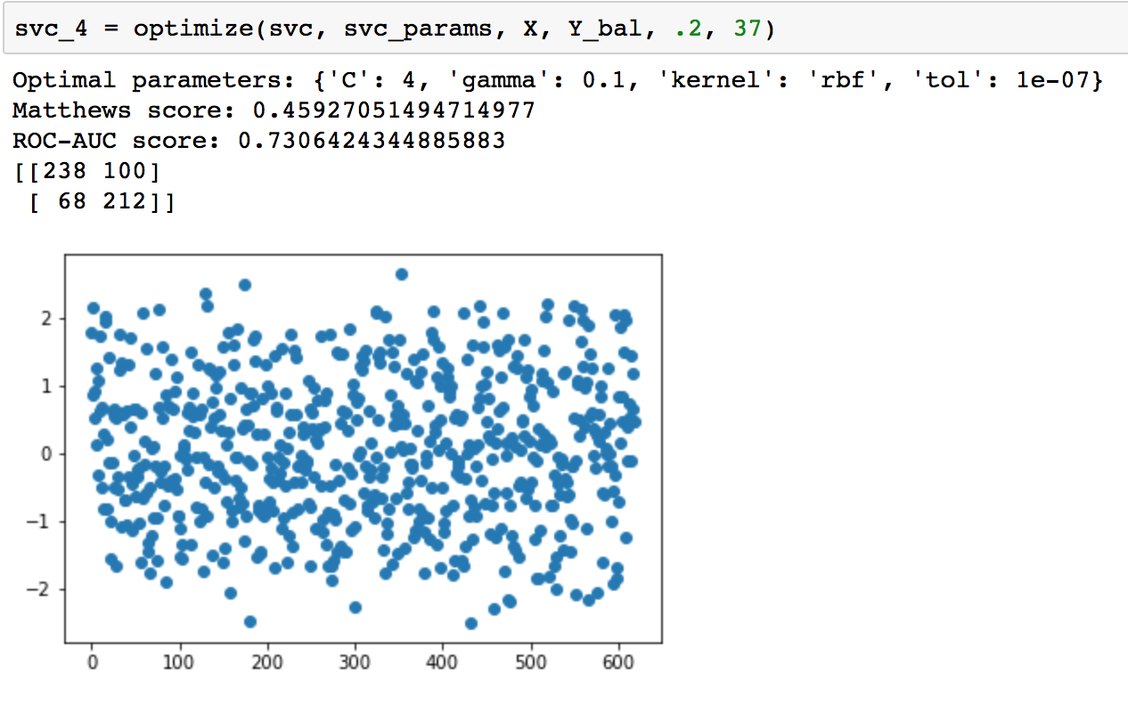
Optimize
unbalanced
balanced
Balancing targets (confusion matrix counts) better improved the results minimally.

Slide 15
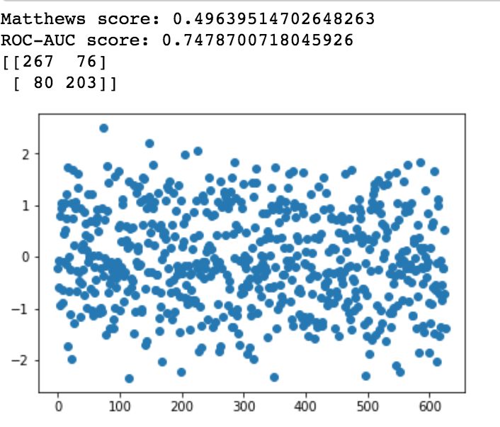
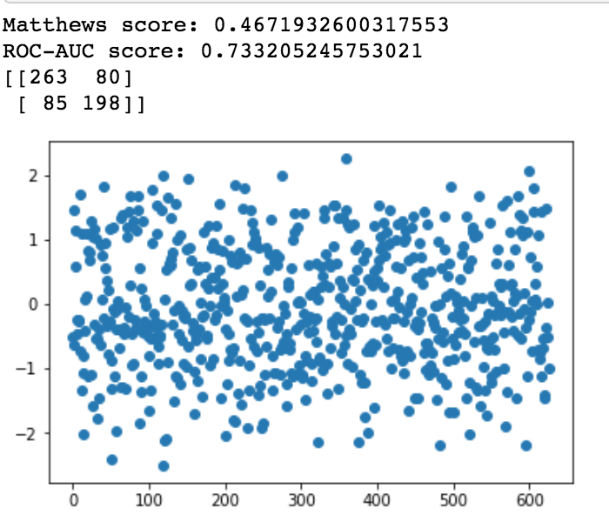
But …
without feature selection
Using all the features produced the best results at the cost of a slight increase in stability. It seems the effects of multicollinearity are not as perceptible when the overall performance of the model is not so good.

Slide 16
Best models (scores)
feat select | Matthews | AUC-ROC | + accuracy | - accuracy
scaled 1 | 0.4561 | 0.7290 | 0.768 | 0.686
scaled 2 | 0.4673 | 0.7347 | 0.785 | 0.680
unscaled 1 | 0.4598 | 0.7309 | 0.771 | 0.686
unscaled 2 | 0.4593 | 0.7306 | 0.777 | 0.679
all 1 | 0.4964 | 0.7479 | 0.769 | 0.728
all 2 | 0.4672 | 0.7332 | 0.756 | 0.712
support
vector
vs
gradient
boosting
scaled 1 | 0.4529 | 0.7268 | 0.757 | 0.696
scaled 2 | 0.4128 | 0.7063 | 0.733 | 0.680
Each of the best models was run with two different data splits (by using two random seeds — 13 and 37). Besides the Matthews and AUC-ROC scores, the chart shows the accuracy predicting high death rates (+) and low death rates (-). Note that the entire modeling process was redone using robust scaling on the data before feature selection (here labeled ‘scaled’), instead of only during modeling (‘unscaled’).

Slide 17
Best models (stability)
param | C | gamma | kernel | tolerance
feat select
scaled | 1 : 4 | .12 : .10 | rbf : rbf | 1e-7 : 1e-7
unscaled | 1 : 4 | .12 : .10 | rbf : rbf | 1e-7 : 1e-7
all | 1 : 1 | .12 : .10 | rbf : rbf | 1e-7 : 1e-7
SVC
learning rate | loss | max depth | min samples leaf | min samples split | num estimators
.10 : .15 | exponential : deviance | 5 : 3 | 1 : 1 | 2 : 3 | 50 : 75
GBC
The minimal differences in the optimal support vector parameters for different data splits contrasts sharply with the variations in all but one of the gradient boosting parameters, even the loss function. SVC is very stable with respect to changes in the data, while GBC is not.

Slide 18


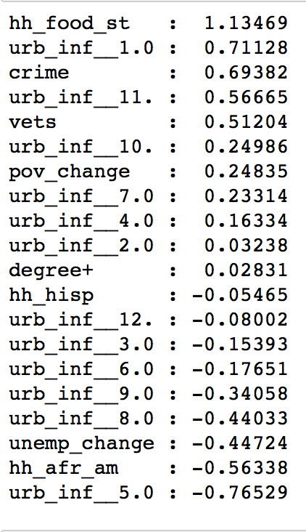

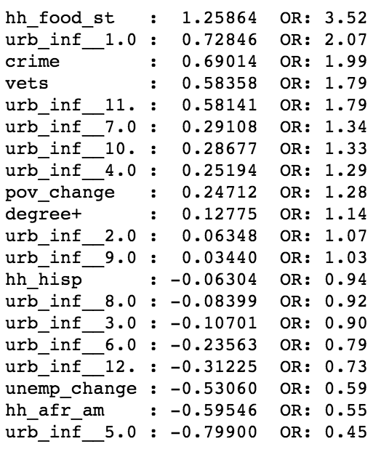
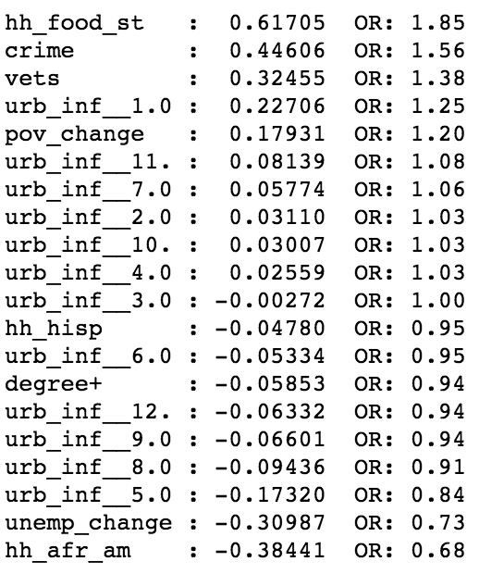



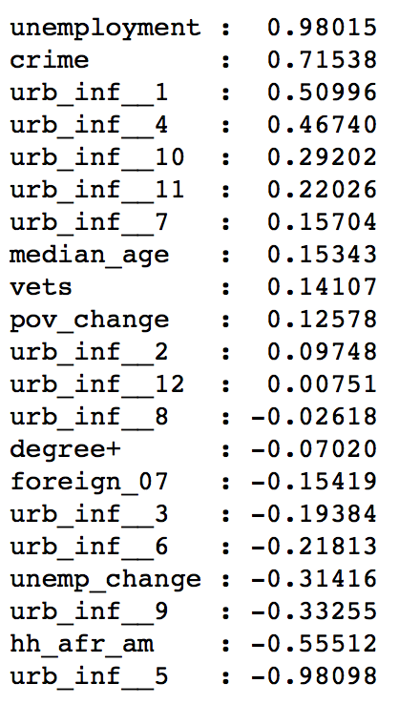

Which features are most important?
The feature ranking from the optimized logistic regression models and the optimized support vector model run with a linear kernel are nearly identical.
The fully scaled model used different parameters, but there is significant overlap, especially given that the unemployment and food stamps features were highly correlated and likely are proxying for each other.

Slide 19
Conclusions
The data has limited predictive power with regard to the targets
Opioid death rates might depend more heavily on unique situational information
Reporting of death rates might not be accurate or consistent
Only the strongest predictors can be relied on
The opioid crisis seems most acute in the largest urban areas, and in small towns far from urban centers (urban influence codes 1 and 11)
It seems to be worse in areas with a high percentage of veterans
It seems least acute in small urban centers (urban influence 3, 5, 8)
It seems highly correlated with poverty and/or use of food stamps, and also with unemployment, but not with the change in unemployment since 2009
It seems least acute in counties with high percentages of African-American households, which also correlate weakly with high food stamps usage
Note: The swarm plots in the earlier slide have bearing on these

Slide 20
Takeaways
Model limitations
Observational data (uncertain relevance, aggregate, incomplete)
Interference (confounding/correlated variables)
Implications
Investigate why smaller urban centers have lowest death rates
Investigate how largest urban centers have higher death rates but counties with higher percentage of African-American households have low rates. Is there a reason? Are these confounding variables?
Look into services for veterans as a strategy to reduce deaths
Are death rates underreported for false positive counties?

